Slide 2
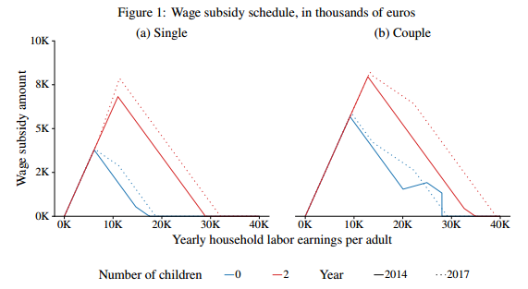
Paper summary
XXX
Asks two related questions:
What are the employment effects of low-income wage subsides/tax-credits?
What are the wage effects of such a subsidy?
Uses a reform in France in 2015:
Decreased and increased marginal tax rates across the low-earner distribution.
Decreased participation tax rates across the low-earner distribution.
From a 10% reduction in the net of participation tax rate:
A 2.7% increase in hours worked.
A 3.1% decline in wages (31% pass through to firms ignoring GE effects).
Extensive margin response with no intensive margin response consistent with literature.

Slide 3
Approach and identification
XXX
Shift-share IV approach.
Each group is a “socio-demographic” group based on characteristics including earnings.
Share is of work hours of this group by region.
Shift an exogenous change in the MTR and PTR due to the policy (at the initial level of earnings).
Differing intensity by region based on hours-weighted change in tax measure (based on pre-reform hours).
Identification requires.
Conditional quasi-random assignment (exogeneity).
Socio-economic groups are substitutes in the labour market (wage spillovers).
Local labour markets are distinct (limited mobility).
Many uncorrelated shock clusters.
Relevance.
This is clearly outlined in the paper, and well argued.
However, have to talk for 10 mins – so here are some thoughts

Slide 4
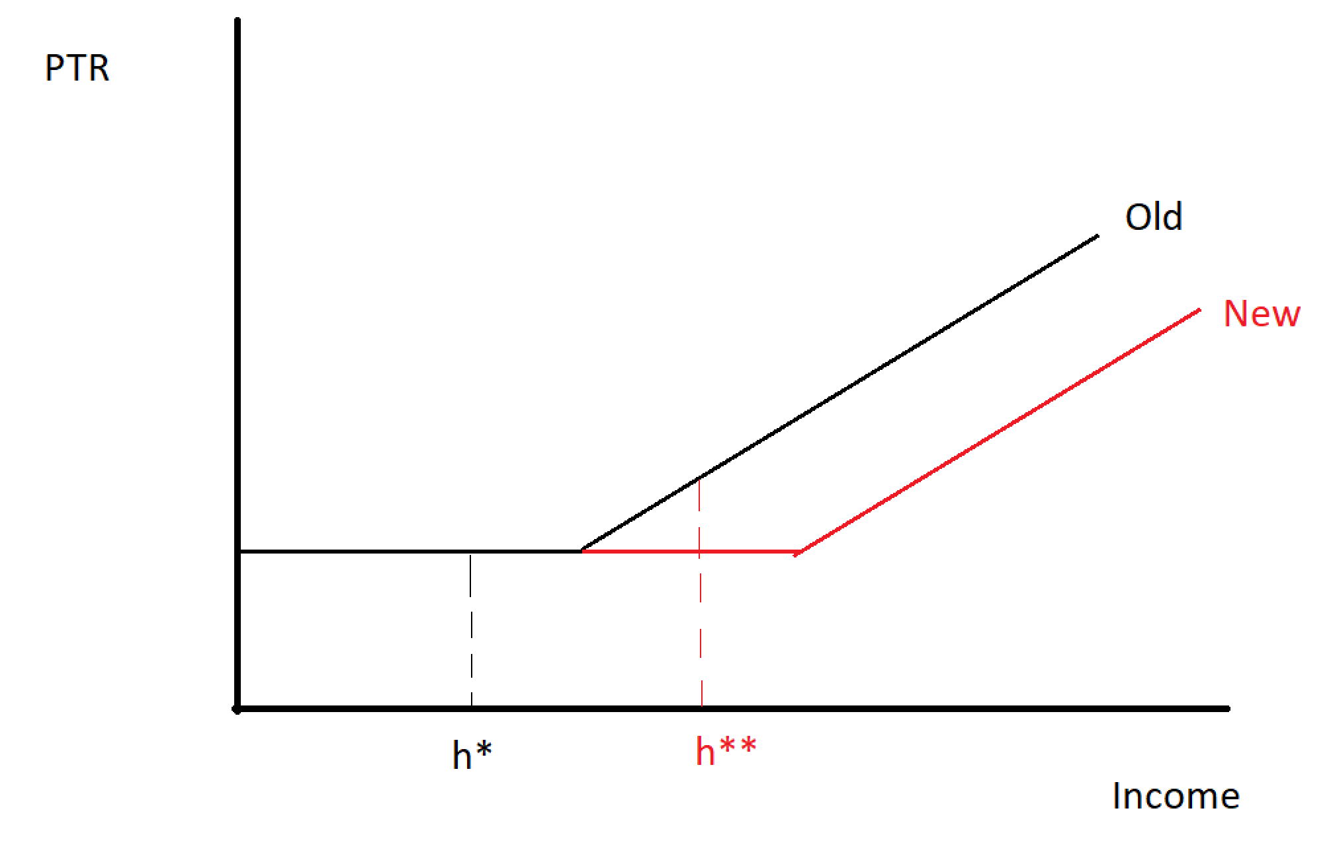
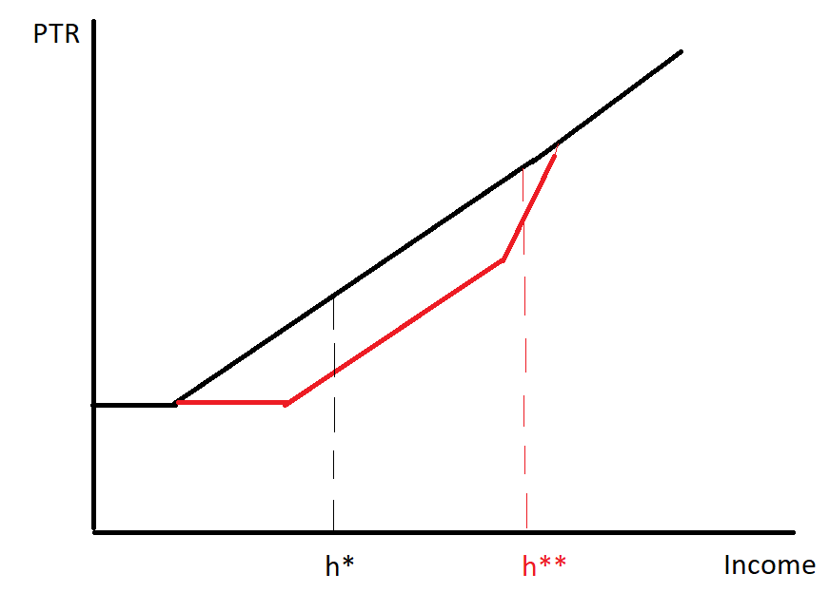
Potential limitations: Interpretation of the shock variable
XXX
The simulated shocks are based on the change in tax incentives from their status quo.
Legitimate method to deal with endogeneity in marginal tax rates due to the progressive scale (motivated wrt ETI literature). Note: Weber (2014) uses taxable income at t-2, rather than t.
But doesn’t account for broader changes in the budget constraint.
This type of change is the main shock that occurs in this reform.
Will characterise individuals with significant extensive margin incentive as having none, and potentially the opposite. Sensitivity: “Reverse reform” approach, tax shock based on earlier tax year.

Slide 5
Potential limitations: Interpretation of the shock variable
XXX
Furthermore, two regions could have the same shock with two very different patterns of treatment.
Two regions with 10 people of same SD characteristics, A and B. In region A 10 people see net PTR fall by 1%, in region B 1 person sees it fall by 10%. Both regions have the same shock.
Sensitivity: Alternative weighting.
However, given the shift share design the instrument does not need to be perfect. So these points do not threaten the core result – and likely suggests the effects are attenuated.
Instrument is exogenous.
Instrument has been shown to be relevant in the PTR case.

Slide 6
Potential limitations: Interpretation of the shock variable
XXX
Furthermore, the simulated shocks are based on the change in tax incentives from their status quo.
Participation rate concern:
Take the individual who receives the largest hour-weighted treatment. On the substitution margin their MTR is unchanged, but the income effect will lower their work incentives.
Take an unemployed individual. On the substitution margin the MTR is lower, and there is no income effect.
However, this instrument would treat the former as treated and the later as untreated.
Second issue is addressed by imputing their income based on characteristics to estimate a treatment intensity (add sensitivity to imputation and selection). But the uncertain relation to work incentives remains.
Sensitivity: “Reverse policy” status quo + additional forms of imputation that deal with selection (Heckman, joint participation and wage estimation).
Note: Not to relevant, can speak to on slide 4 without showing.

Slide 7
Potential limitations: Importance of randomly-assigned-shocks
XXX
Due to the shock being designed and released at the national level, these shocks can be seen as (conditionally) randomly assigned – i.e. individuals in the same positions in different areas would receive the same treatment.
However, there is a risk that the political process did drive a design based on differential expected outcomes for some regions in the future. As a placebo, parallel trends are used to motivate identification.
Chaisemartin & Lei (2022): Under parallel trends, heterogenous treatment effects can bias results.
The combination of instrument measurement (which may generate artificial heterogeneity in treatment, even if true treatment effects are homogenous) and concerns about aggregation of heterogeneous treatment can bias estimates.
Suggestion: Report heterogenous treatment effects and show underlying weights.

Slide 8
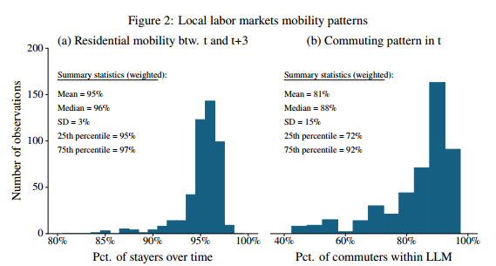
Potential limitations: Mobility
XXX
Mobility between regions shown to be limited over the period.
However, the key interest is mobility among treated individuals.
Key would be to show limited mobility by treatment intensity.
Significant mobility would also likely attenuate the effects (although the effect is unclear as mobility will tend to be to high exposure regions).

Slide 9
Other questions
XXX
The imputation of wages for non-participants is done via OLS. Heckman selection model an alternative.
Equivalisation of earnings: No standard scale used, would be good to check sensitivity of socio-demographic groups on the basis of OECD scale.
Sensitivity to unbalanced panel.
Sensitivity to alternative weighting (population share rather than hours weighted share)
Additional information on mobility of individuals by treatment intensity.
Reporting heterogeneity in treatment and underlying weights (sensitivity to random-assigned shocks failing).
General equilibrium effects (what happens to the level).
Not really a question: There is imperfect take-up, when prior policies had low or full take-up. These changes in treatment status may themselves be informative of behavioural responses and warrant investigation (i.e. take-up costs ala Ko and Moffit (2022)).

Slide 10
Extra Pictures
XXX

